Slide 1
Week 5
Privacy, anonymity and paranoia

Slide 2

What does your browser know?
IP
Tracking Cookies
Browser fingerprinting
Network monitoring
Webkay.robinlinus.com

Slide 3
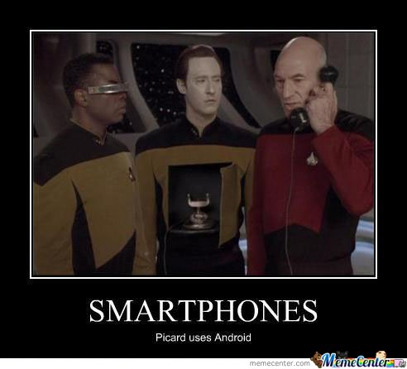
What does your smartphone know
App permissions
Sensors
Location
Supercookies
Sound/video
Wi-Fi broadcasting
Terms of service and EULAs

Slide 4
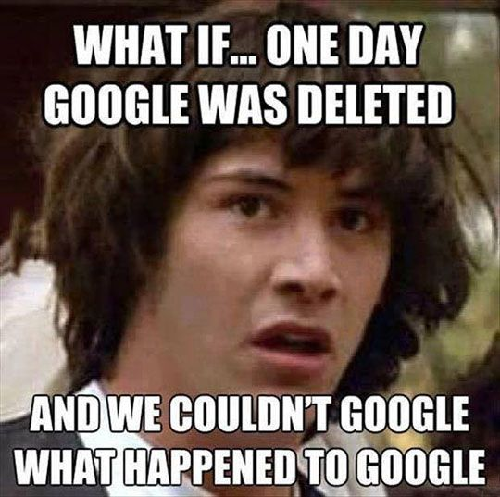
What does google know?
Search history
Emails contents
Purchases
Associations
How to opt out of Google's AI training

Slide 5
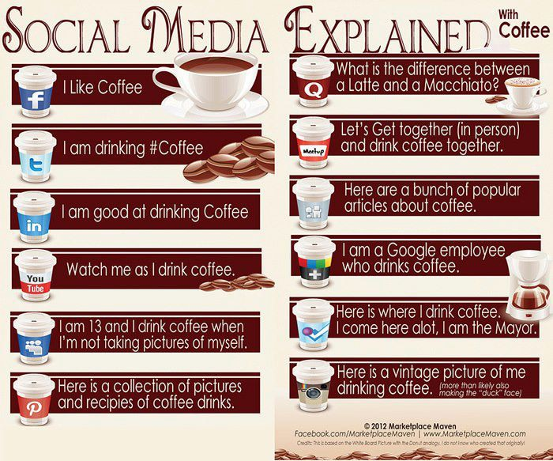
What does social media know
If you have the app, anything you gave permissions for
What you interact with
What you look like
Knowledge based questions (and answers)
Opting out of AI training

Slide 6
What Does the AI in Everything Know?
Meta: since December 16, 2025, chats with Meta AI are used to target ads, with no opt-out in the US
  Source: TechCrunch
LinkedIn: uses member data to train AI by default, so you have to opt out
  Source: TechCrunch
Google: a 2026 settings change keeps more of your uploaded images, audio, and video to improve its AI
Microsoft Recall: screenshots your screen every few seconds. After privacy experts raised alarms, Microsoft made it opt-in, and apps like Signal now block it
  Source: CNN
Hidden or confusing opt-outs are a dark pattern

Slide 7
What your “likes” say about you
https://www.ted.com/talks/jennifer_golbeck_the_curly_fry_conundrum_why_social_media_likes_say_more_than_you_might_think

